Slide 1

Second Part: Data Structure - Doubly Linked List
Mr. Zukile Ndyalivana

Slide 2
As previously stated, a Doubly Linked List is:
Another linked list.
Also
Doubly linked list has:
An additional pointer known as the previous pointer in its node apart from the data part and the next pointer as in the singly linked list.

Slide 3

A node in the doubly linked list looks as follows:

Slide 4
Please note that:
“Prev” and “Next” are pointers to the previous and next elements of the node respectively.
The ‘Data’ is the actual element that is stored in the node.

Slide 5
Important points to be consider:
Doubly Linked List contains:
A link element called first and last.
NB: Each link:
Carries a data field(s) and two link fields called next and prev.
Each link is linked with its next link:
Using its next link.
Each link is linked with its previous link using its previous link.
The last link carries a link as null to mark the end of the list.

Slide 6
Basic Operations
Following are the basic operations supported by a list.
DoublyLinkedList(): Makes an empty doubly linked list.
isEmpty():Returns true if the doubly linked list does not contain any item.
size(): Returns the number of items in the doubly linked list.
get(int index): Returns the item at the specified index.
addFirst(Item item): Inserts the specified item at the head of the doubly linked list.

Slide 7
addLast(Item item): Inserts the specified item at the tail of the doubly linked list.
add(int index, Item item): Inserts the specified item at the specified index.
Item removeFirst(): Retrieves and removes the head of the doubly linked list.
Item removeLast(): Retrieves and removes the tail of the doubly linked list.
Item remove(int index): Retrieves and removes the item at the specified index.

Slide 8
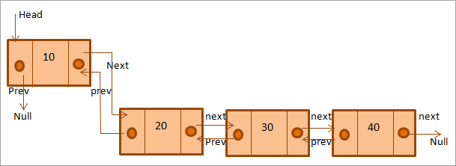
The following figure shows a doubly linked list.
A
B
C
D

Slide 9
The above diagram shows the doubly linked list.
There are four nodes in this list.
As you can see:
the previous pointer of the first node, and the next pointer of the last node is set to null.
The previous pointer set to null indicates that this is the first node in the doubly linked list
On the other side
the next pointer set to null indicates the node is the last node.

Slide 10
Advantages
As each node has pointers pointing to the previous and next nodes,
the doubly linked list can be traversed easily in forward as well as backward direction.
You can quickly add the new node just by changing the pointers.
Similarly,
For delete operation
since we have previous as well as next pointers,
the deletion is easier
And we need not traverse the whole list to find the previous node as in case of the singly linked list.

Slide 11
Note:
In singly linked list,
to delete a node, pointer to the previous node is needed.
To get this previous node, sometimes the list is traversed.
In DLL, we can get the previous node using previous pointer.

Slide 12
Disadvantages
Since there is:
An extra pointer in the doubly linked list i.e.
the previous pointer additional memory space is required to store this pointer
As well as the next pointer
And data item.
All the operations like :
addition, deletion, etc. require that both previous and next pointers are manipulated thus imposing operational overhead.
In actual sense , carrying out the above two operations:
take more time than linear linked list because more pointer operations are required than linear linked list.

Slide 13
Implementation In Java
The implementation of doubly linked list in Java comprises of creating
A doubly-linked list class,
the node class
and adding nodes to the doubly linked list.
The addition of new nodes is usually done at the end of the list.

Slide 14
Memory Representation
A doubly linked list is maintained using linear arrays in the memory the same as a single linked list
The exception
Doubly linked list requires FIRST and LAST both pointer variables and one more pointer field in the node PREV.
However the list for available space in the list is represented in the same manner.

Slide 15
class DoublyLinkedList {
//A node class for doubly linked list
class Node{
String data;
Node previous;
Node next;
// create the constructor
public Node(String item) {
this.item = item;
}
}
Prev
data
Next

Slide 16
Inserting the a new node at the end of the Doubly Linked List
The algorithm
Define a method called addAtEnd
Add node to the list,
first check whether the head is null,
then it will insert the node as the head.
Both head and tail :
will point to a newly added node.
Head's previous pointer:
will point to null
And tail's next pointer will point to null.
If the head is not null,
insert the new node at the end of the list
Then make the new node's previous pointer to point to the tail.
The new node will become the new tail.
Tail's next pointer will point to null.

Slide 17
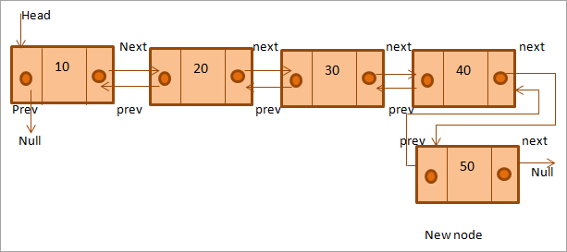
The below diagram shows the addition of the new node at the end of the doubly linked list.
A
B
C
D
E

Slide 18
Insert a node at a particular position
Algorithm:
A new node with given element is created.
If the insert position is 1,
then the new node is made to head.
Otherwise,
traverse to the node that is previous to the insert position
And check if it is null or not.
In case of null,
the specified position does not exist.
In other case, update the links.

Slide 19
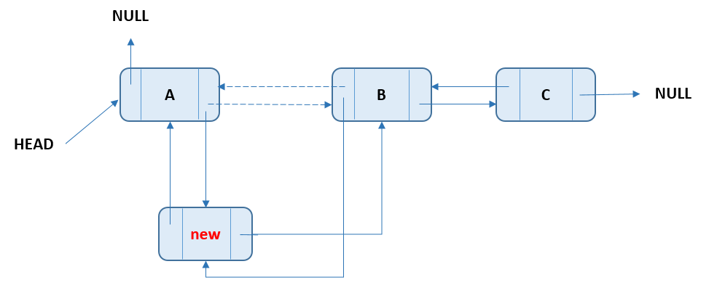

Slide 20
How to Remove the first node in a Doubly Linked List in Java
The logic:
if List is Empty
then throws NoSuchElementException Exception
if List is not empty
then
head assigns to temp Node
if head == tail that means list has only one Node so nullify tail node
if List has more than one Node then nullify head.next.previous
so that first’s node next and next Node’s previous pointer disconnects.
3. Afterward,
the head’s move to the next pointer and temp’s next pointer nullify.

Slide 21
